Slide 1
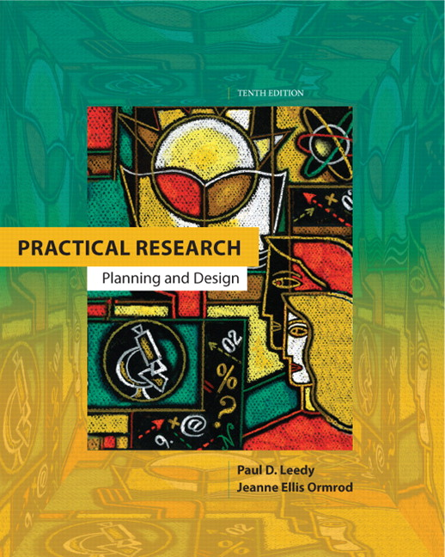
Practical Research
Planning and Design
Tenth Edition
Original Presentation By:
Paul D. Leedy
Jeanne Ellis Ormrod
Modified and Enhanced By:
Yun Zhang
Tahmina Ahmed
Prosunjit Biswas
© 2013, 2010, 2005, 2001, 1997 Pearson Education, Inc. All rights reserved.

Slide 2
Chapter 1
The Nature and Tools of Research
1-1

Slide 3

Research is:
A systematic process of collecting, analyzing, and interpreting information (data) to increase understanding of a phenomenon about which we are interested or concerned.
Leedy & Ormrod
Practical Research: Planning and Design, 10e
© 2013 Pearson Education, Inc. All rights reserved.
1-2

Slide 4
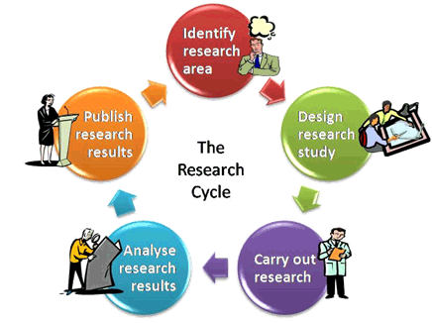
Formal Research :
Intentionally enhancing the understanding
Of a phenomenon and communicating that to the larger scientific community.
Leedy & Ormrod
Practical Research: Planning and Design, 10e
© 2013 Pearson Education, Inc. All rights reserved.
1-3

Slide 5
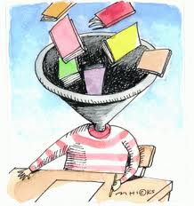

What Research Is Not:
Only gathering information.
Put effort to just collect hard-to-locate information
Only Transporting facts from one location to another
Leedy & Ormrod
Practical Research: Planning and Design, 10e
© 2013 Pearson Education, Inc. All rights reserved.
1-4

Slide 6



Characteristics of Research
Originates with a question or problem
Requires clear articulation of a goal
Requires a specific plan for proceeding
Leedy & Ormrod
Practical Research: Planning and Design, 10e
© 2013 Pearson Education, Inc. All rights reserved.
1-5

Slide 7
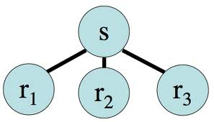
Characteristics of Research …
Divides Problems to
sub-problems
Is guided by the specific research problem, question, or hypothesis
Requires a specific plan for proceeding
Accepts certain critical assumptions
Requires the collection and interpretation of data
Is, by its nature, cyclical or helical
Leedy & Ormrod
Practical Research: Planning and Design, 10e
© 2013 Pearson Education, Inc. All rights reserved.
1-6

Slide 8
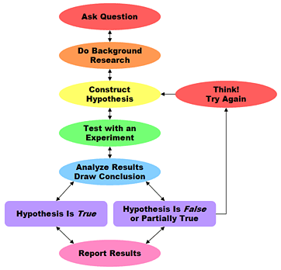
Hypothesis:
A logical supposition, a reasonable guess, an educated conjecture which provides a tentative explanation for a phenomenon under investigation.
Leedy & Ormrod
Practical Research: Planning and Design, 10e
© 2013 Pearson Education, Inc. All rights reserved.
1-7

Slide 9
Assumptions:
Assumptions are self-evident truths. A statement
by the researchers that certain element of the
research are understood to be True.
Leedy & Ormrod
Practical Research: Planning and Design, 10e
© 2013 Pearson Education, Inc. All rights reserved.
1-8

Slide 10
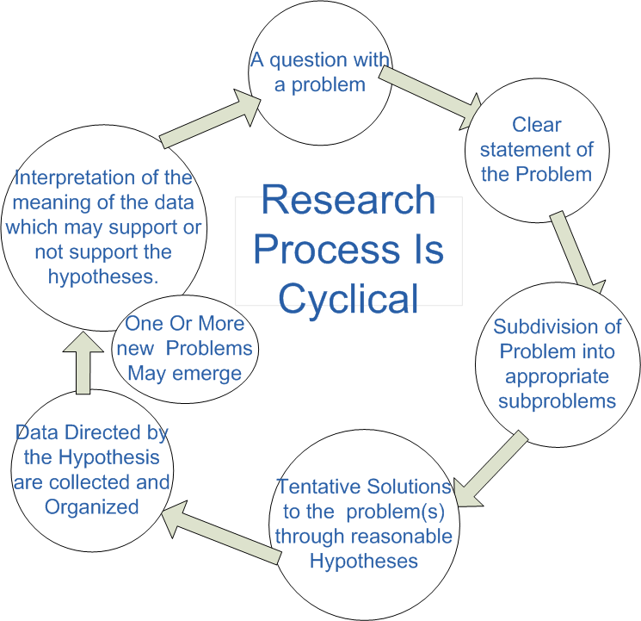
Leedy & Ormrod
Practical Research: Planning and Design, 10e
© 2013 Pearson Education, Inc. All rights reserved.
1-9

Slide 11
Research Tools:
Specific mechanisms or strategies the researcher
uses to collect, manipulate, or interpret data.
Research Methodology:
The general approach the researcher takes carrying out the research Project. This approach dictates the particular tools the researcher selects.
Leedy & Ormrod
Practical Research: Planning and Design, 10e
© 2013 Pearson Education, Inc. All rights reserved.
1-10

Slide 12






Six Tools of Research
The library and its resources Computer technology
Measurement Statistics
The
Language Human Mind
Leedy & Ormrod
Practical Research: Planning and Design, 10e
© 2013 Pearson Education, Inc. All rights reserved.
1-11

Slide 13


The Library and Its Resources
Human societies use libraries to assemble and store knowledge
Store information in more compact forms
microforms, compact disks, online databases
Fast and efficient means of locating and accessing information on virtually any topic
Available on the Internet
Leedy & Ormrod
Practical Research: Planning and Design, 10e
© 2013 Pearson Education, Inc. All rights reserved.
1-12

Slide 14
Computer Technology
Compact and portable
calculate, compare, search, retrieve, sort, and organize data
Be a fast and faithful assistant
Planning the study
Literature review
Study implementation and data gathering
Analysis and interpretation
Reporting
Leedy & Ormrod
Practical Research: Planning and Design, 10e
© 2013 Pearson Education, Inc. All rights reserved.
1-13

Slide 15

Measurement
To identify a systematic way of measuring a phenomenon being studied
Measurement instrument
Everyday measurement instruments
Rulers,scales,speedometers
Specialized instruments
High-powered telescope(astronomer)
No concrete physical phenomena need measurement
Questionnaire(sociologist)
Leedy & Ormrod
Practical Research: Planning and Design, 10e
© 2013 Pearson Education, Inc. All rights reserved.
1-14

Slide 16

Statistics
Principal functions:
Describe the data
Draw inferences from the data
More useful in some academic disciplines than in others
Calculating statistics is not the final step in a research project
Leedy & Ormrod
Practical Research: Planning and Design, 10e
© 2013 Pearson Education, Inc. All rights reserved.
1-15

Slide 17
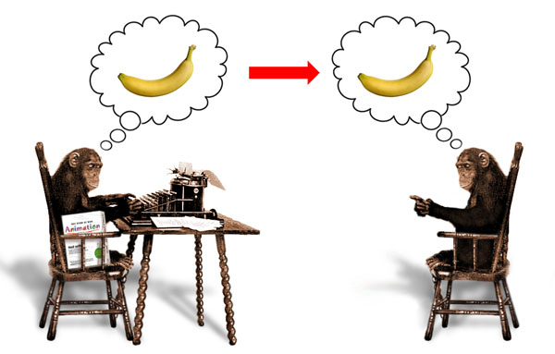
Language
Enable us to think more effectively
The concepts that the words represent enhance our thinking in several ways:
Words reduce the world’s complexity
Words allow abstraction of the environment
Words enhance the power of thought
Words facilitate generalization and inference drawing in new situations
The value of knowing two or more languages
The importance of writing
Leedy & Ormrod
Practical Research: Planning and Design, 10e
© 2013 Pearson Education, Inc. All rights reserved.
1-16

Slide 18
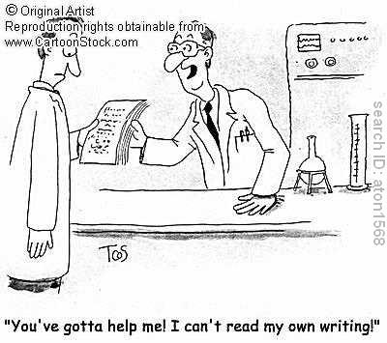
Writing to Communicate
Say exactly what you mean.
Continually keep in mind your primary objective in writing your paper, and focus your discussion accordingly.
Provide an overview of what you will be talking about in upcoming pages.
Organize your ideas into general and more specific categories, and use headings and subheadings to guide your readers through your discussion of these categories.
Use concrete examples to make abstract ideas more understandable.
Leedy & Ormrod
Practical Research: Planning and Design, 10e
© 2013 Pearson Education, Inc. All rights reserved.
1-17

Slide 19

Writing to Communicate
Use figures and tables to help you more effectively present or organize your ideas and findings.
At the conclusion of a chapter or major section, summarize what you have said.
Anticipate that you will almost certainly have to write multiple drafts.
Fastidiously check to be sure that your final draft uses appropriate grammar and punctuation, and check your spelling.
Leedy & Ormrod
Practical Research: Planning and Design, 10e
© 2013 Pearson Education, Inc. All rights reserved.
1-18

Slide 20

Reasoning Tools for Research
Critical Thinking
Deductive Logic
Inductive Reasoning
The Scientific Method
Theory Building
Leedy & Ormrod
Practical Research: Planning and Design, 10e
© 2013 Pearson Education, Inc. All rights reserved.
1-19

Slide 21

Critical Thinking
Components of Critical Thinking:
- verbal reasoning
- argument analysis
- decision making
- critical analysis of prior research
Ask Questions….:
-What does it mean ?
-What does it mean to others?
- What are examples / use-cases?
- How does this apply to real life?
-- and so on.
Leedy & Ormrod
Practical Research: Planning and Design, 10e
© 2013 Pearson Education, Inc. All rights reserved.
1-20

Slide 22
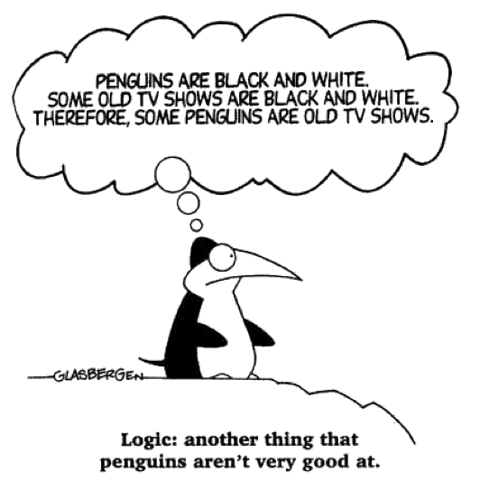


Deductive Logic
Given one or more premises which is taken to be true. Conclusion or decision is being made logically from this premises.
Leedy & Ormrod
Practical Research: Planning and Design, 10e
© 2013 Pearson Education, Inc. All rights reserved.
1-21

Slide 23
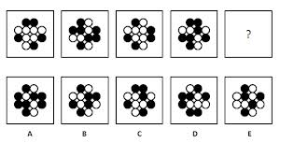
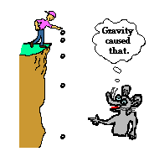
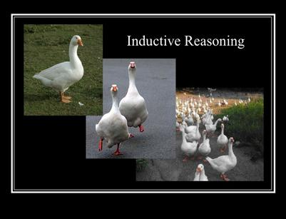
Inductive Reasoning
reasoning from detailed facts to general principles. Also called “bottom up” reasoning.
Leedy & Ormrod
Practical Research: Planning and Design, 10e
© 2013 Pearson Education, Inc. All rights reserved.
1-22

Slide 24
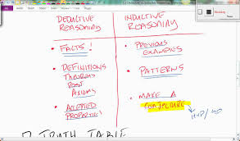
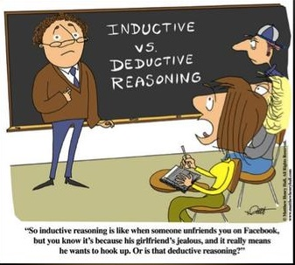
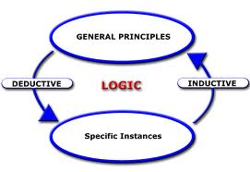
Inductive vs Deductive Reasoning
Leedy & Ormrod
Practical Research: Planning and Design, 10e
© 2013 Pearson Education, Inc. All rights reserved.
1-23

Slide 25
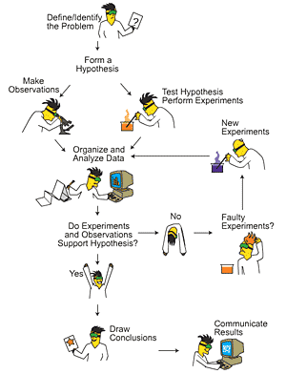
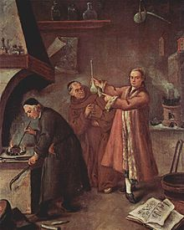
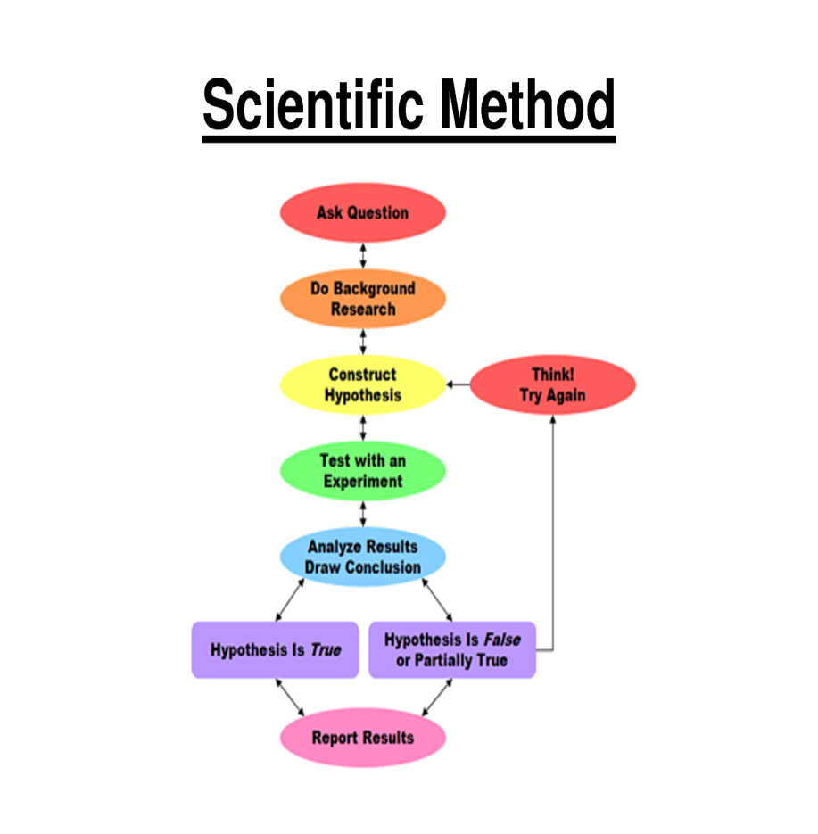
The Scientific Method:
The scientific method is a set of techniques for investigating phenomena, acquiring new knowledge, or correcting and integrating previous knowledge
Leedy & Ormrod
Practical Research: Planning and Design, 10e
© 2013 Pearson Education, Inc. All rights reserved.
1-24

Slide 26
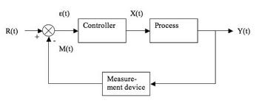
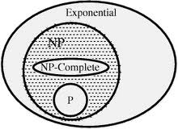
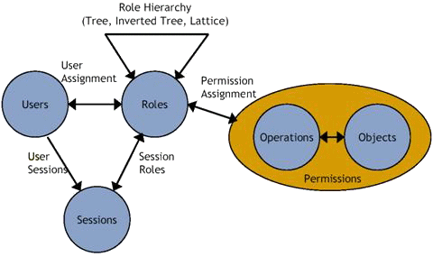

Theory Building
Theory Building is people making sense of the world around them. We all do it all the time. Kids build theory about where they come from.
Leedy & Ormrod
Practical Research: Planning and Design, 10e
© 2013 Pearson Education, Inc. All rights reserved.
1-25

Slide 27
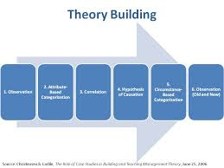
Theory Building Continuing…
What it takes to build a theory?
Steps:
1. Observe
2. Organize
3. Find Co-relation
4. Create hypothesis
5. Justify Hypothesis
6. Build Model
Leedy & Ormrod
Practical Research: Planning and Design, 10e
© 2013 Pearson Education, Inc. All rights reserved.
1-26

Slide 28

Human Mind as Tools of Research
Eventually, it is you who decide.
Leedy & Ormrod
Practical Research: Planning and Design, 10e
© 2013 Pearson Education, Inc. All rights reserved.
1-27

Slide 29

Collaboration collaboration Brings Power.
What is collaboration?
Who to Collaborate with?
bet^{n} Individuals
bet^{n} Groups
Industry vs Institution
and so on…
Example:
IBM University Research and Collaboration
Through Intern, Fellowship, grant etc.
Leedy & Ormrod
Practical Research: Planning and Design, 10e
© 2013 Pearson Education, Inc. All rights reserved.
1-28

Slide 30
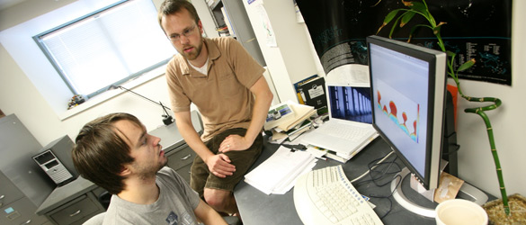
How to Collaborate as a PhD Student
Be open
- discuss what you are doing and what others doing.
Participation in discussion groups
Find Collaborator
Collaboration with Friends or Lab-mates
Collaboration with Friends at other university
Keep looking
-Internship/ Fellowship
-Industry leader / researcher
Maintain Network
ResearchGate
LinkedIn
Leedy & Ormrod
Practical Research: Planning and Design, 10e
© 2013 Pearson Education, Inc. All rights reserved.
1-29

Slide 31

Exploring Research In your Field
Keeping an eye on
-Known conferences / workshops
Industry work
Other researchers
Whitepaper
Blogs / Magazine
Leedy & Ormrod
Practical Research: Planning and Design, 10e
© 2013 Pearson Education, Inc. All rights reserved.
1-30

Slide 32

Leedy & Ormrod
Practical Research: Planning and Design, 10e
© 2013 Pearson Education, Inc. All rights reserved.

